Slide 1
Lecture 4
Visualization, AutoEncoder
Most material from Fei Fei Li’s course at Standford University

Slide 2
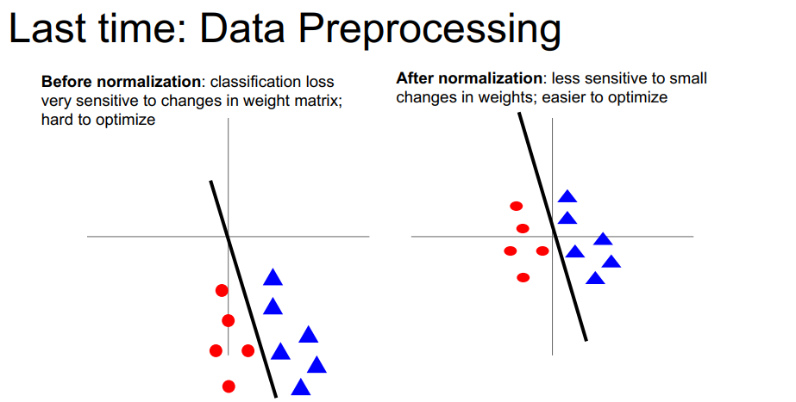

Slide 3
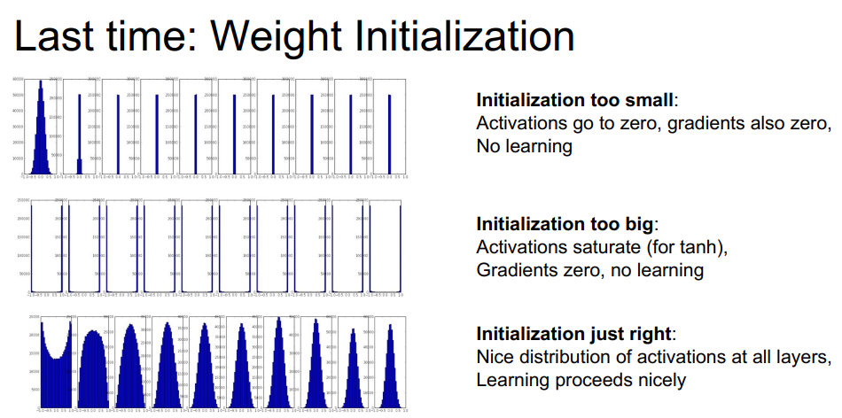

Slide 4
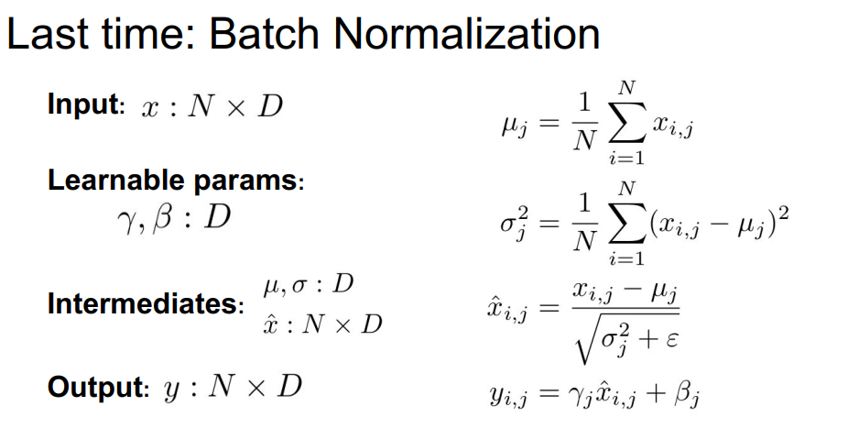

Slide 5
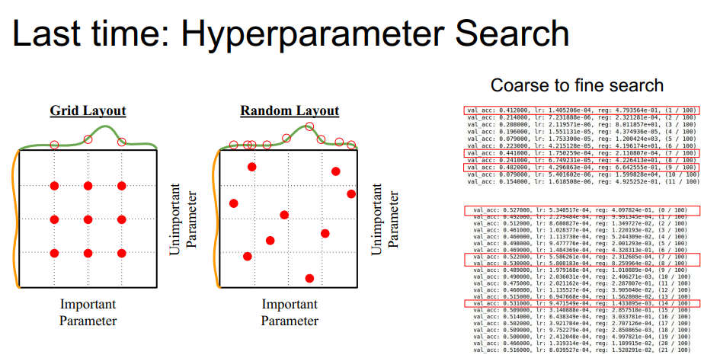

Slide 6
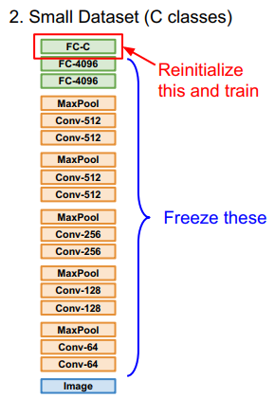
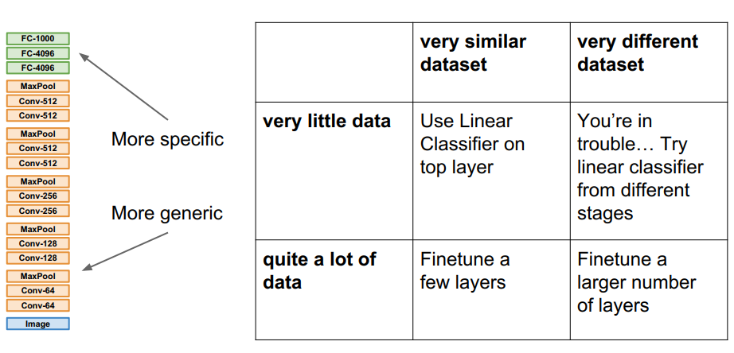
Last Time:Transfer Learning

Slide 7
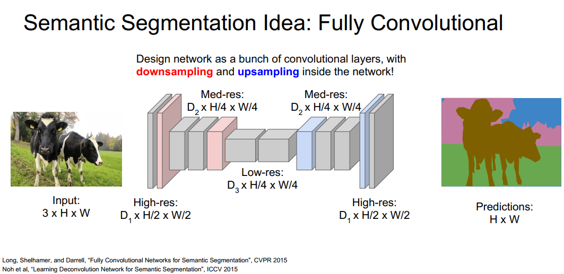
Last Time: Image Segmentation:

Slide 8
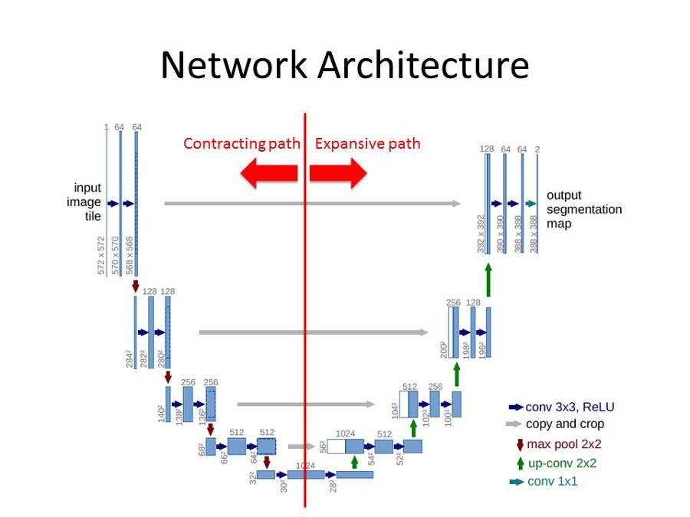
Last Time: Image Segmentation:
UNet

Slide 9
Today
Visualization
Auto-Encoder

Slide 10
Visualization

Slide 11
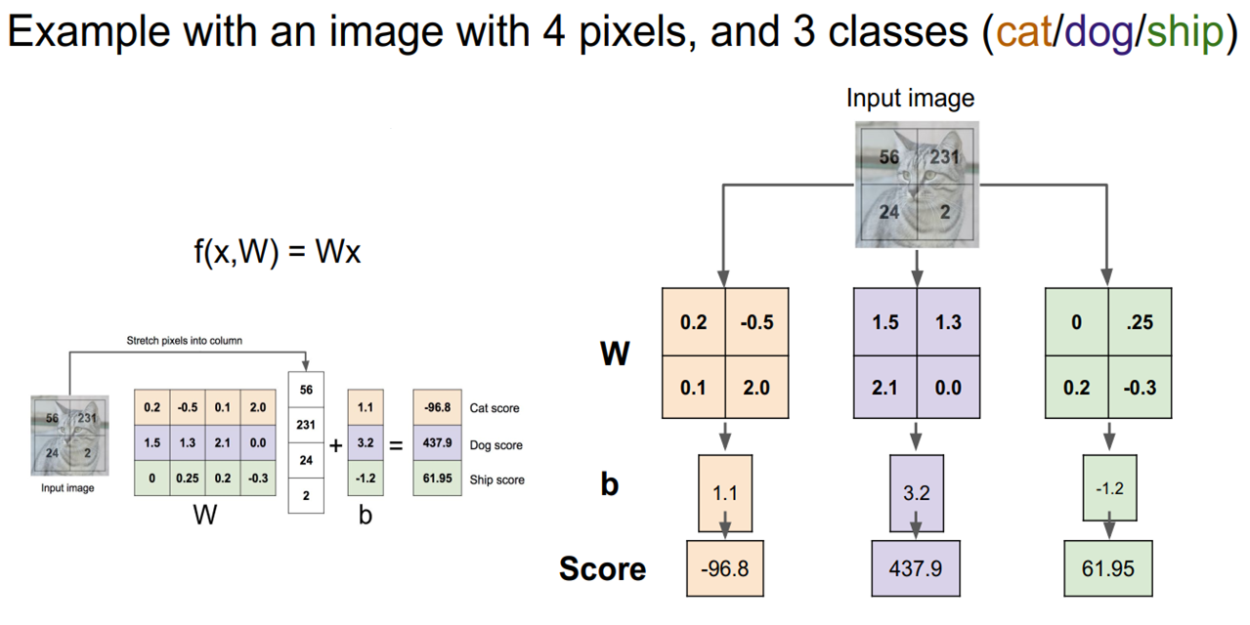
Visualization: Linear Classification

Slide 12
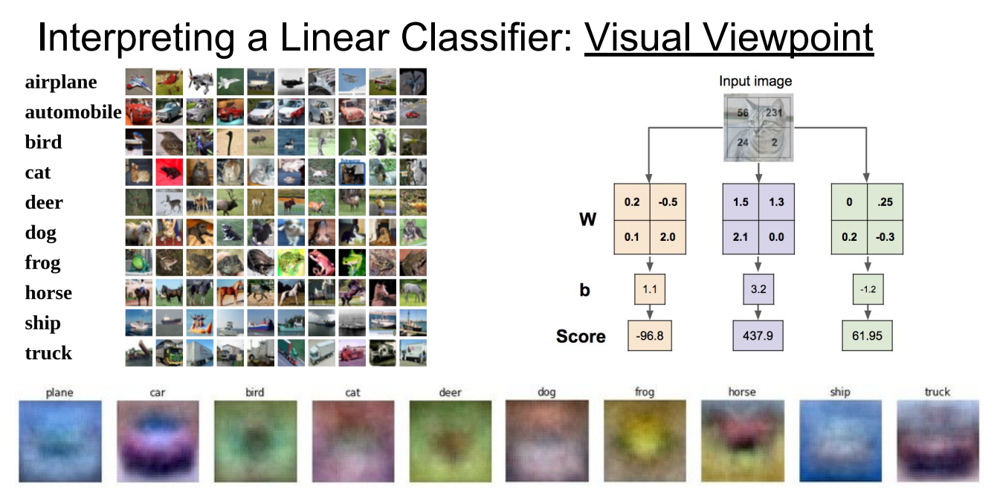
Visualization: Linear Classification

Slide 13
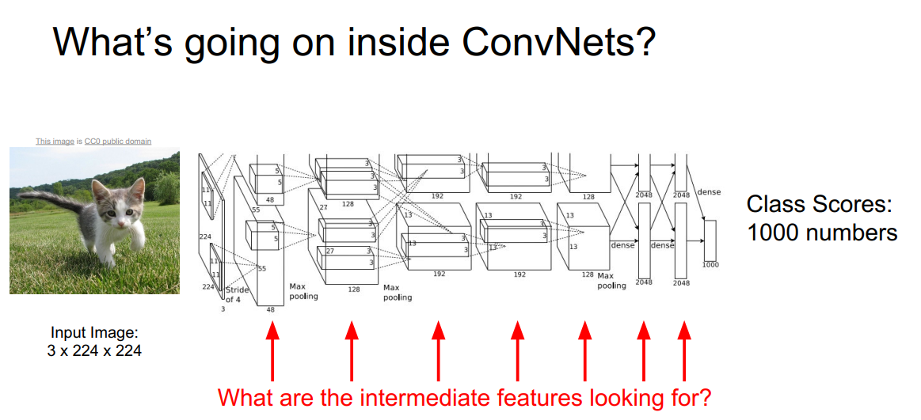
Visualization: Convolutions

Slide 14
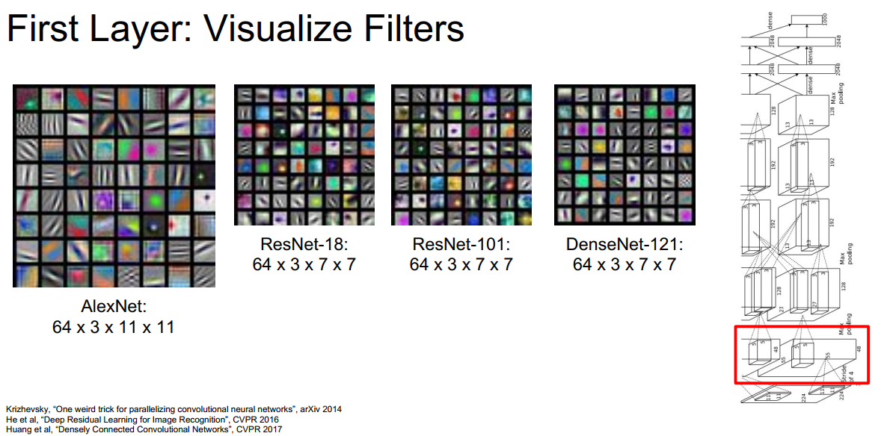
Visualization: Convolutions

Slide 15
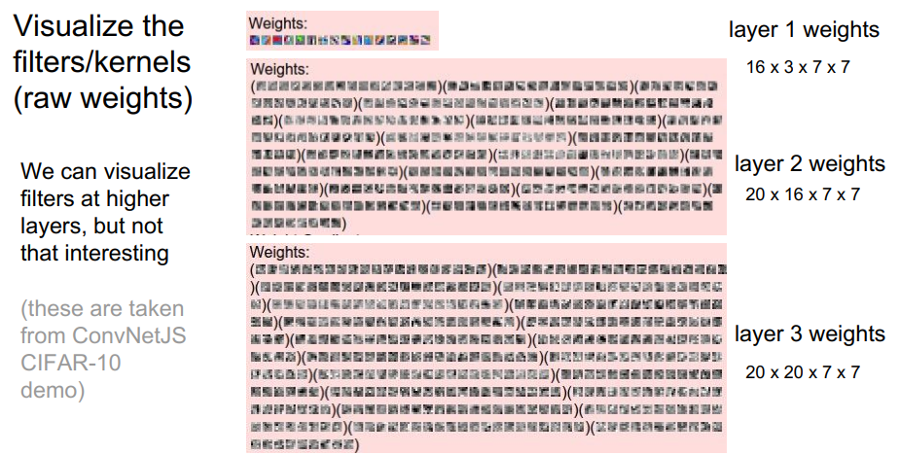
Visualization: Convolutions

Slide 16
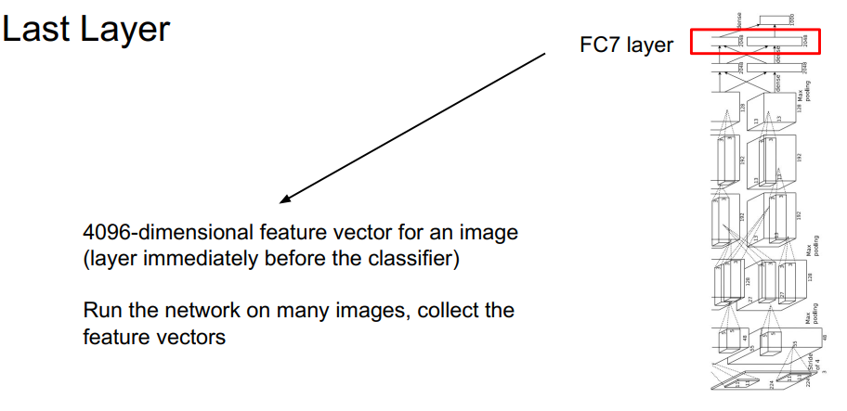
Visualization: Convolutions

Slide 17
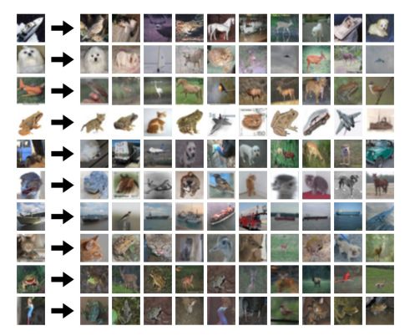
Visualization: Convolutions
K-Nearest Neighbors

Slide 18
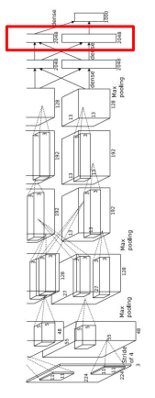
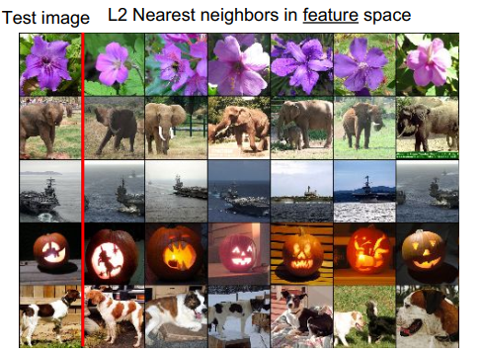
Visualization: Convolutions
Last Layer: Nearest Neighbors

Slide 19
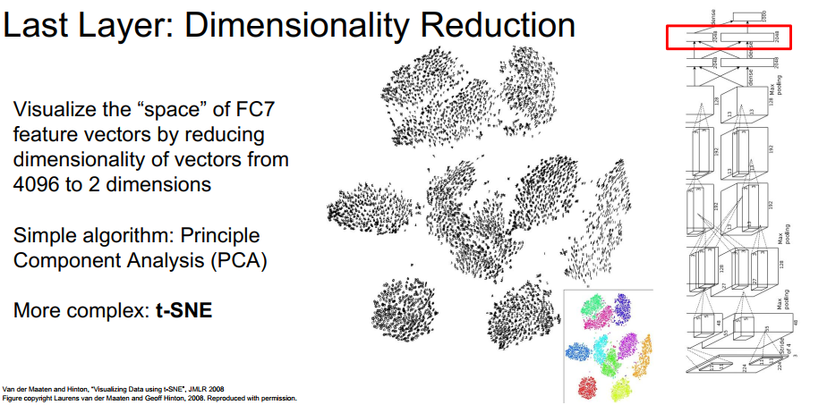
Visualization: Convolutions

Slide 20
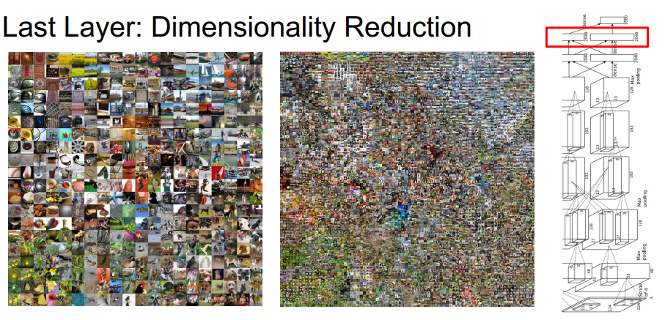
Visualization: Convolutions
See high-resolution versions at:
http://cs.stanford.edu/people/karpathy/cnnembed/

Slide 21
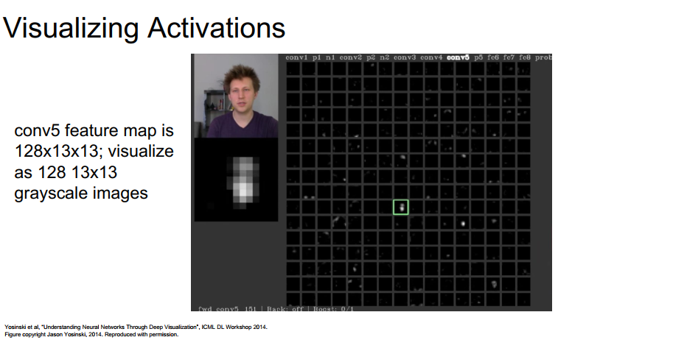
Visualization: Convolutions

Slide 22
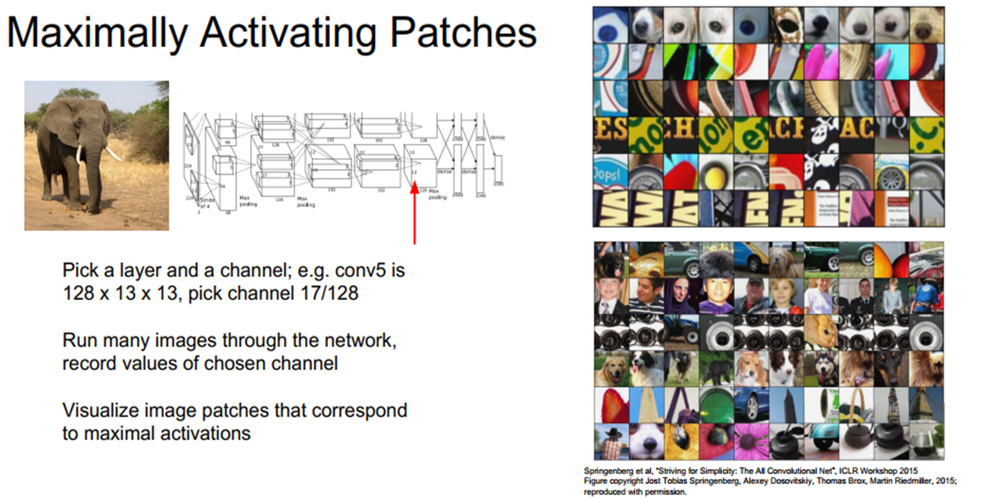
Visualization: Convolutions

Slide 23
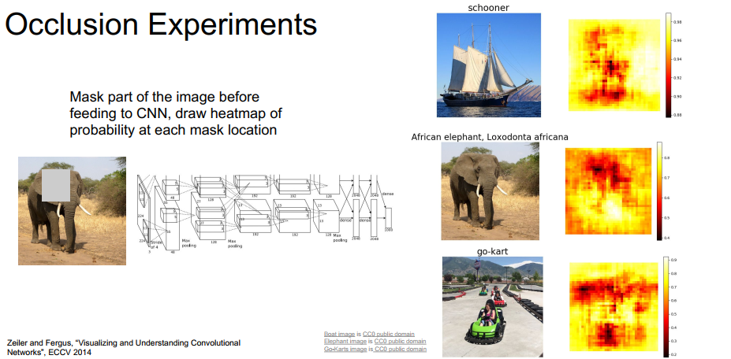
Visualization: Convolutions

Slide 24
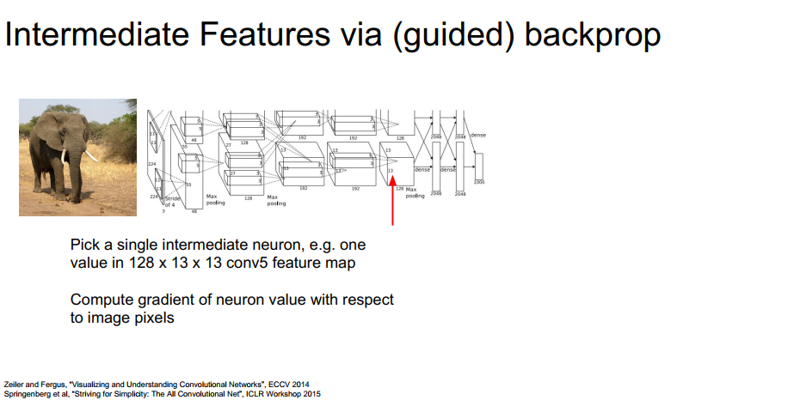
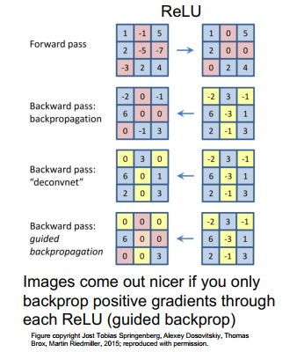
Visualization: Convolutions

Slide 25
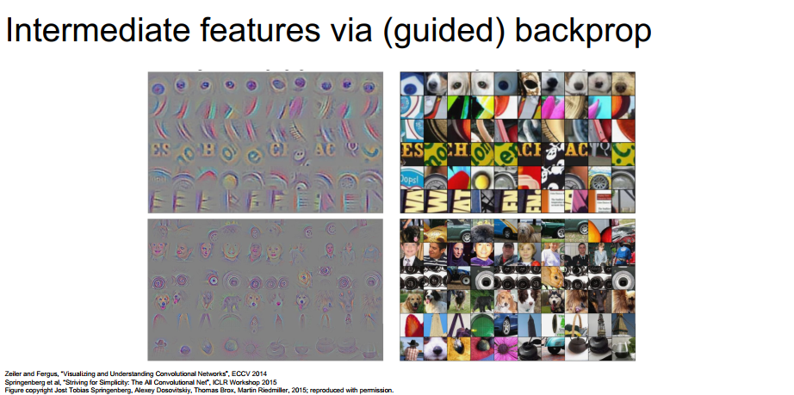
Visualization: Convolutions

Slide 26
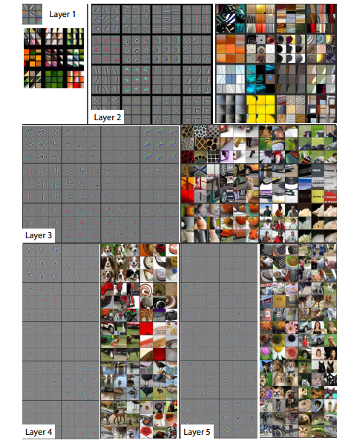
Visualization: Convolutions

Slide 27
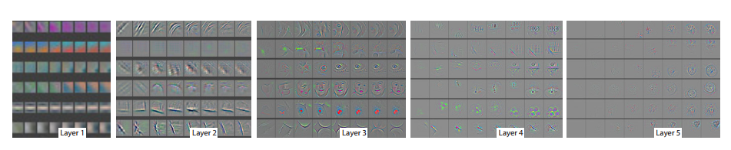
Visualization: Convolutions
Epochs = [1, 2, 5, 10, 20, 30, 40, 64]

Slide 28
Auto-Encoders

Slide 29
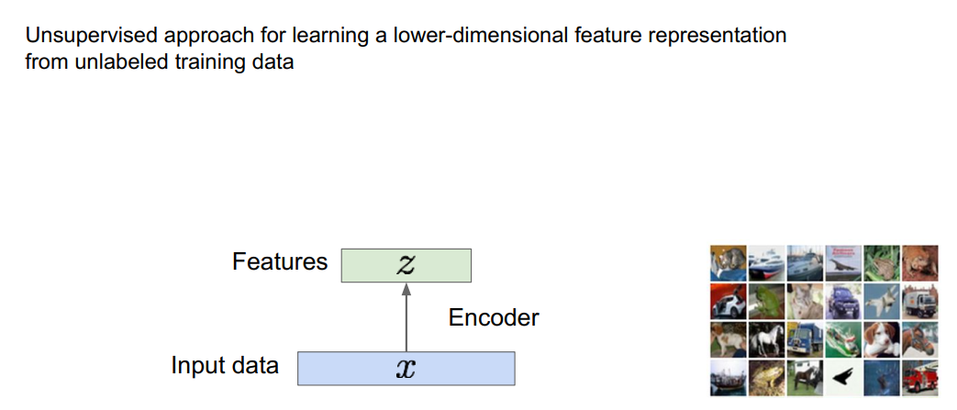
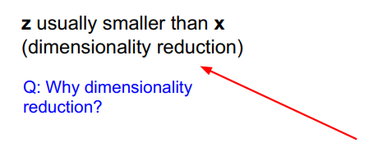
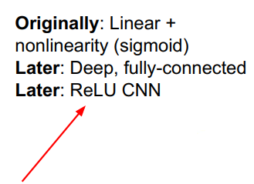
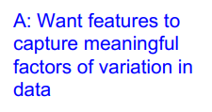
Auto-Encoders

Slide 30
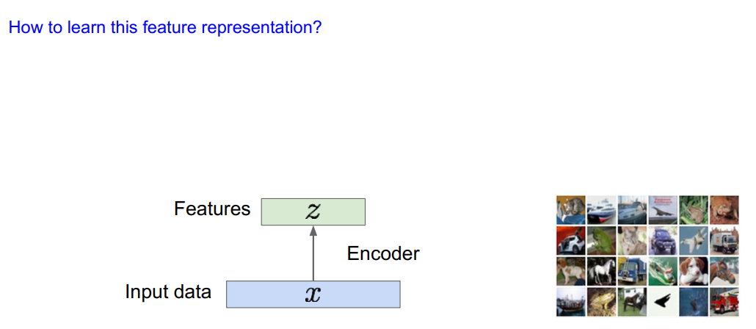
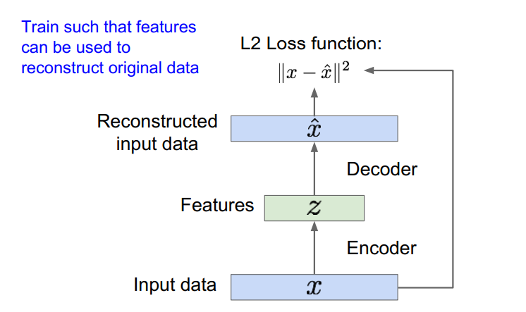
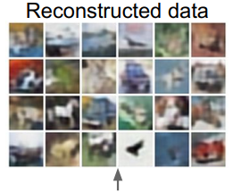

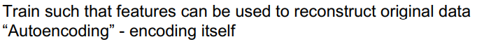
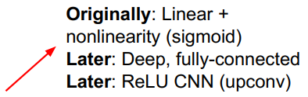
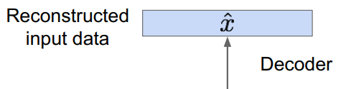
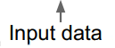
Auto-Encoders

Slide 31
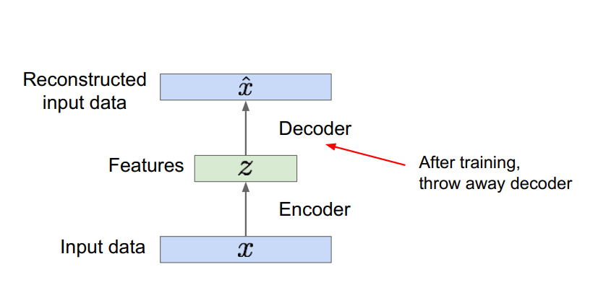
Auto-Encoders

Slide 32
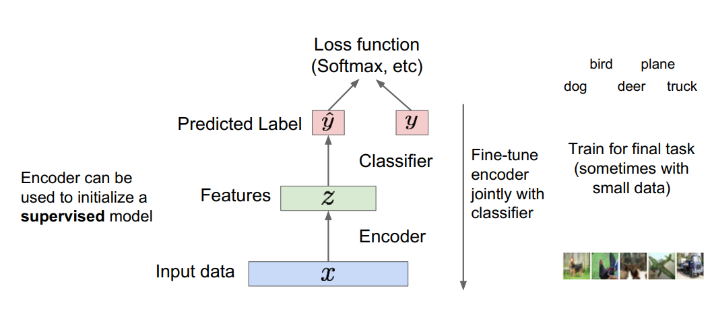
Auto-Encoders

Slide 33
UpSampling

Slide 34
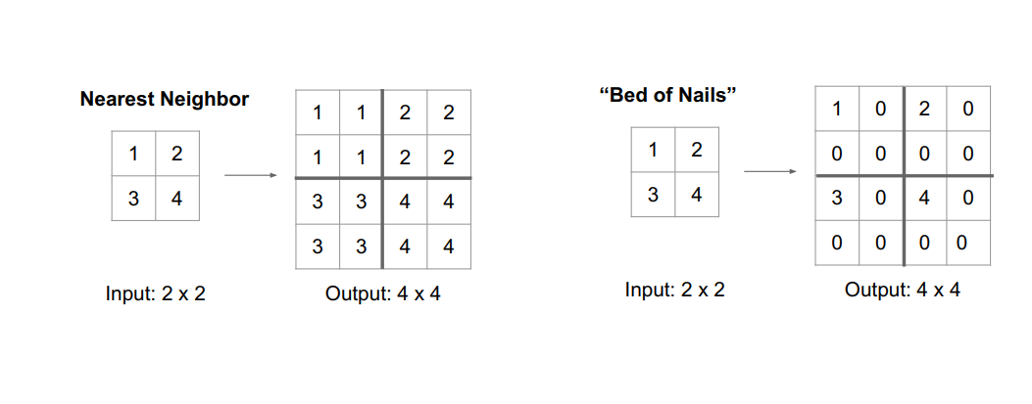
UpSampling: Unpooling

Slide 35
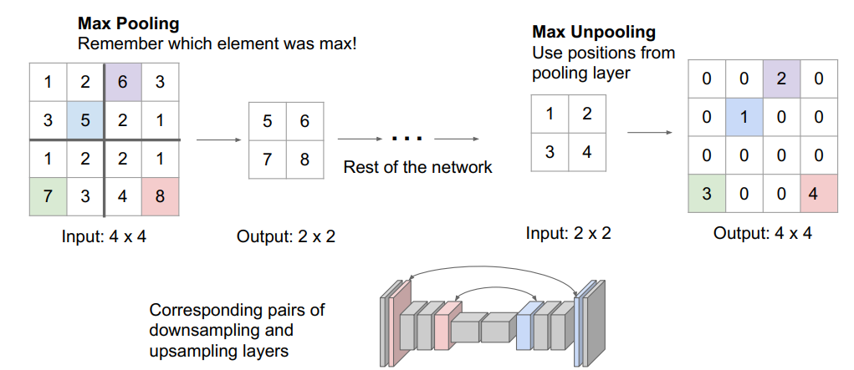
UpSampling: Unpooling

Slide 36
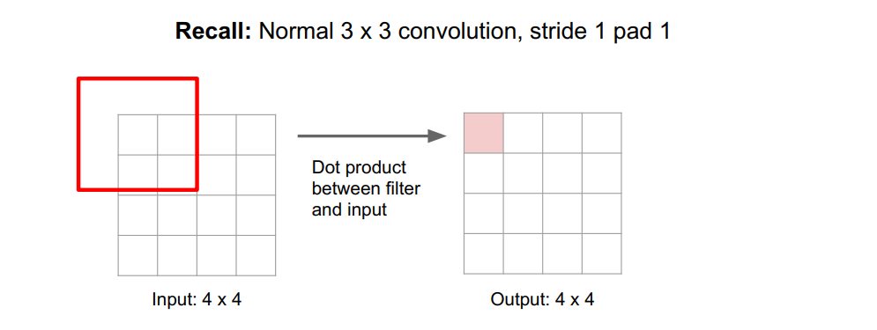
UpSampling: Convolution

Slide 37
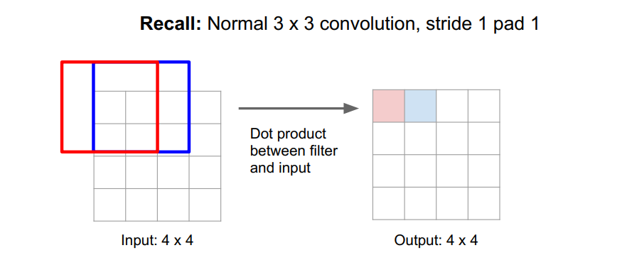
UpSampling: Convolution

Slide 38
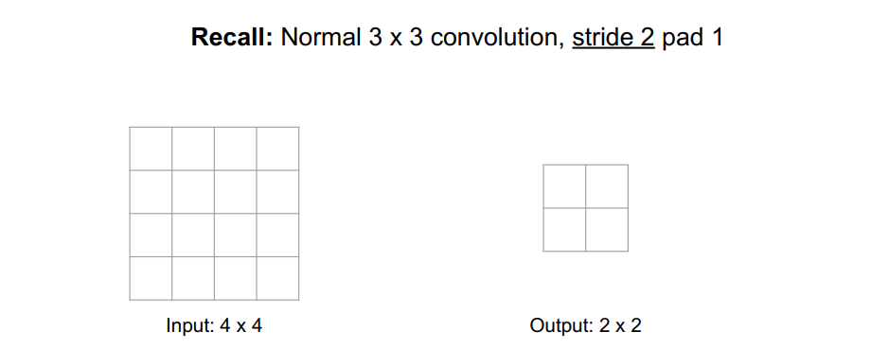
UpSampling: Convolution

Slide 39
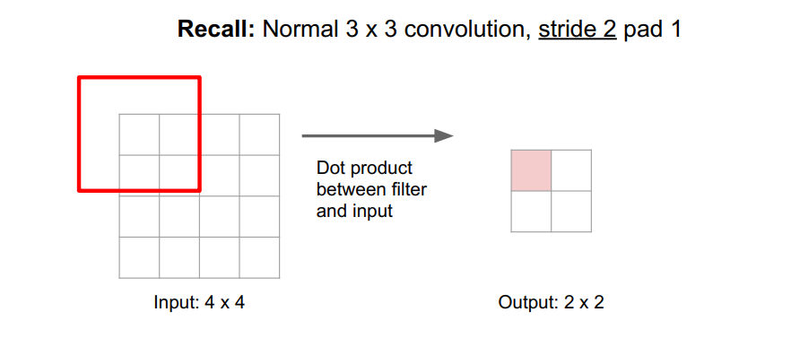
UpSampling: Convolution

Slide 40
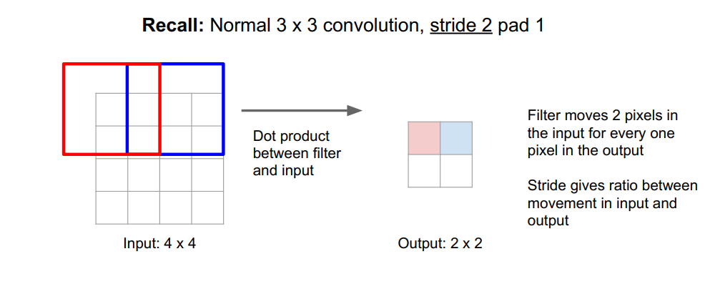
UpSampling: Convolution

Slide 41
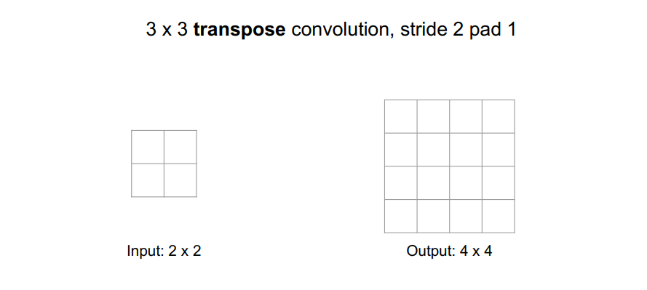
UpSampling: Transpose Convolution

Slide 42
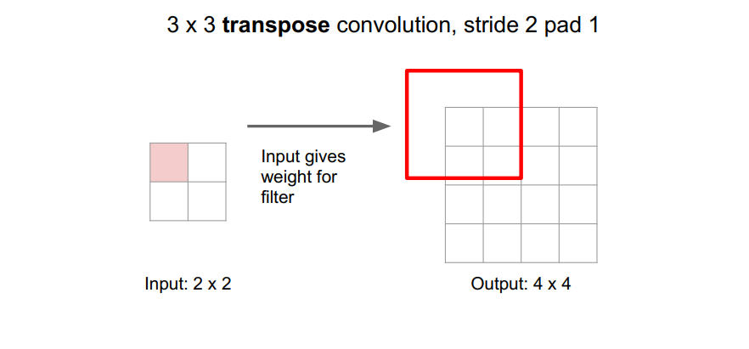
UpSampling: Transpose Convolution

Slide 43
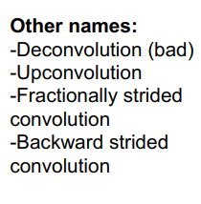

UpSampling: Transpose Convolution

Slide 44

UpSampling: Transpose Convolution

